Slide 1
Predictive model to allocate resources for non operational emergencies
April / 2023
Cristian Camilo Herreño Mojica

Slide 2
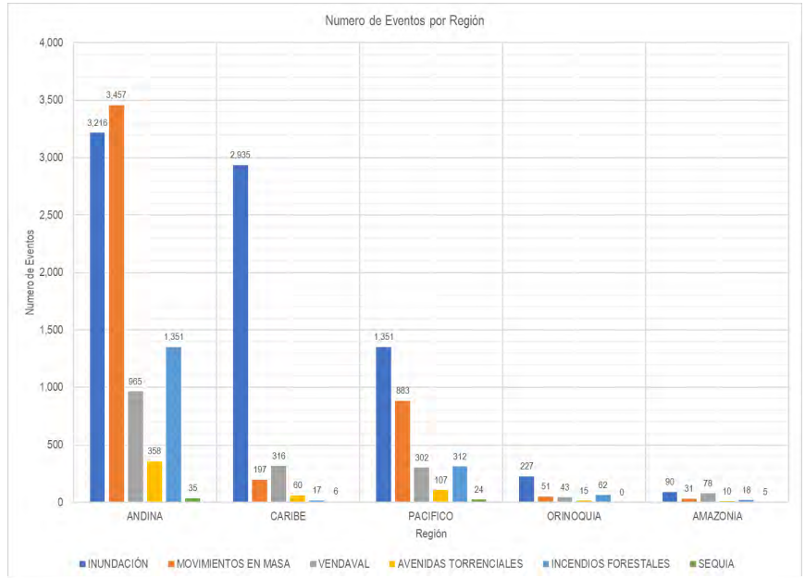
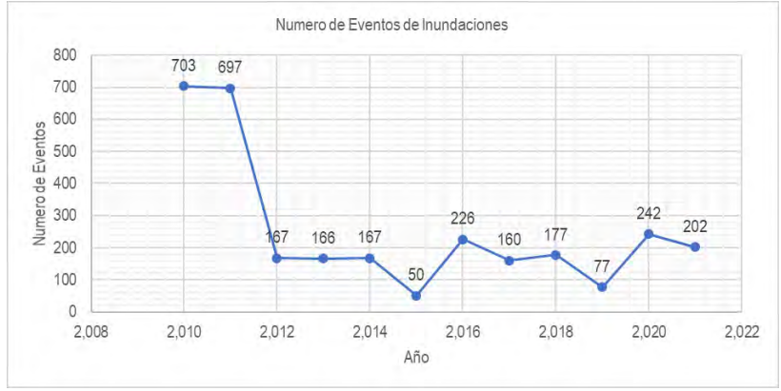
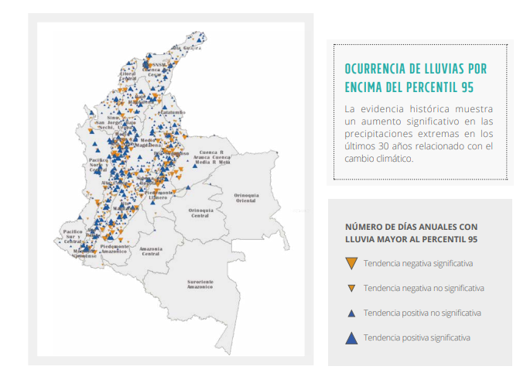

Climate data 2010-2022
Number of Events by Region between September 15 and December 15, period 1914 – 2021. Source: National Unit for Disaster Risk Management. National Response Plan Report, Second Rainy Season 2022.
Floods and mass movements are the most prominent events in the last 100 years, most frequently in the Andean zone, which includes the Central, Central West and Catatumbo-Arauca regions. In second place is the Caribbean zone, corresponding to the Caribbean region. In fourth place of affectation is the Orinoco zone, which includes the Orinoco and Piedmont regions.
Sources: Climate Risk (IDEAM et al., 2017. RESULTS - IDEAM (cambioclimatico.gov.co)

Slide 3
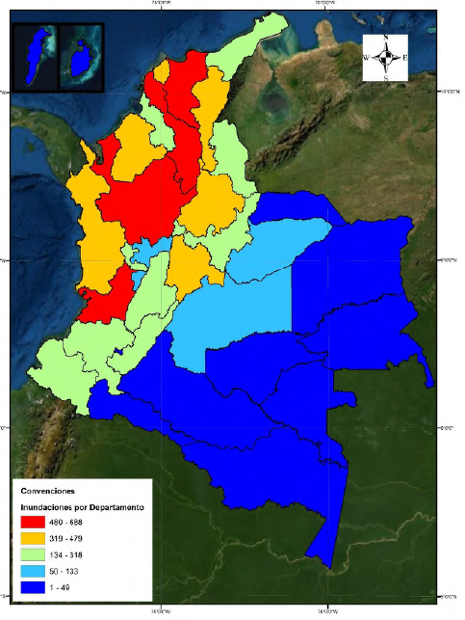
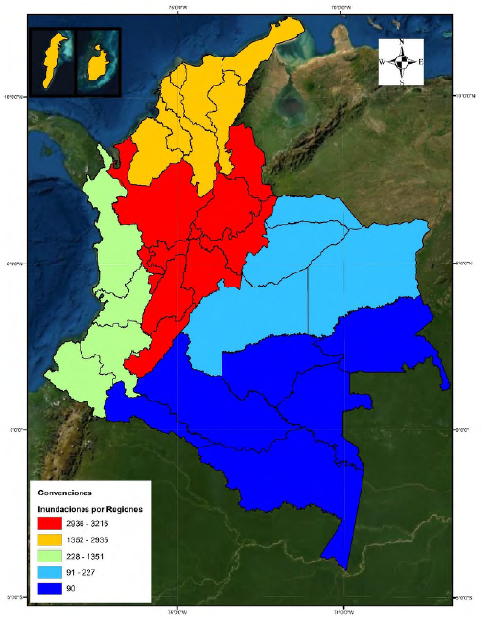
Historical Record of Disaster Events
Number of flood events recorded by department between 15 Sep. and 15 Dec 1914-2021
Number of flood events recorded by region between 15 Sep. and 15 Dec 1914-2021
Source: National Unit for Disaster Risk Management. National Response Plan Report, Second Rainy Season 2022.

Slide 4
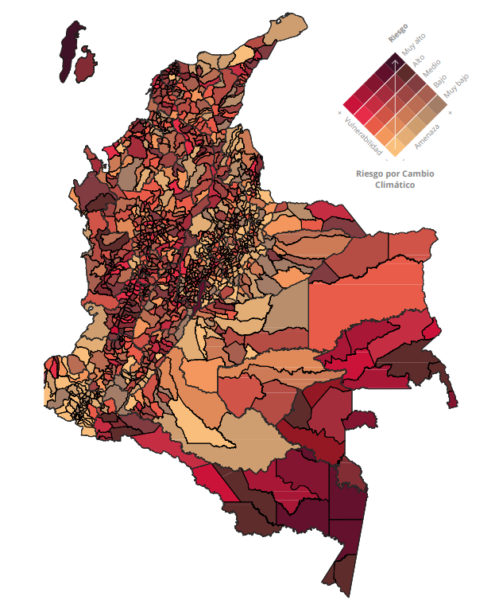
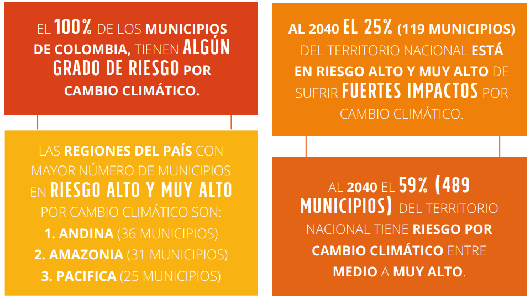
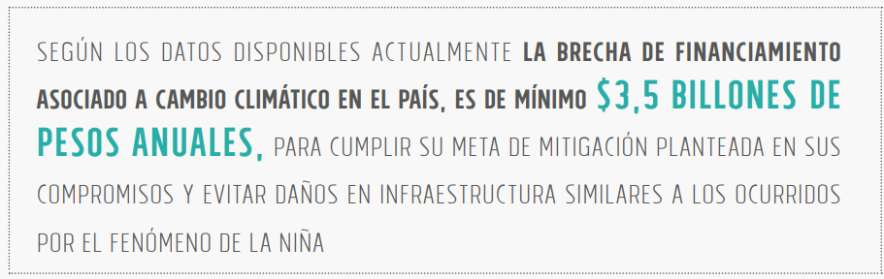
VULNERABILITY AND RISK FROM CLIMATE CHANGE
Colombia faces the challenge of generating better and greater knowledge about climate change, with a view to promoting sound decision-making in risk management and adaptation to the phenomenon.
The Climate Change Risk Index, an analysis carried out by IDEAM and UNDP in 2017, is composed of 3 components of threat, sensitivity and adaptive capacity based on 113 indicators for 6 territorial dimensions corresponding to food security, water resources, biodiversity and ecosystem services, health, human habitat and infrastructure.
Sources: Climate Risk (IDEAM et al., 2017. RESULTS - IDEAM (cambioclimatico.gov.co)

Slide 5
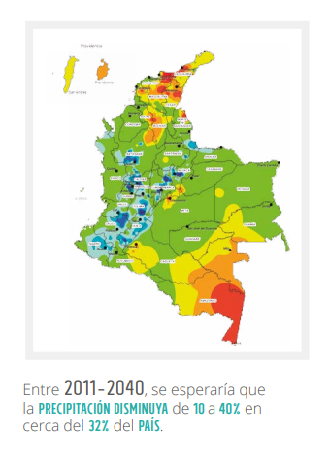
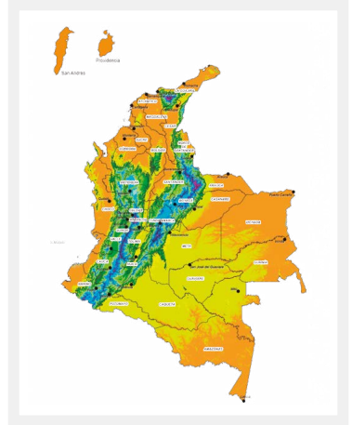
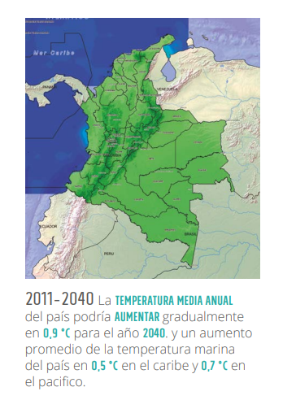
Climate Projections 2040
The greatest increases in temperature would occur in the Andean region, especially for regions such as Sogamoso, Catatumbo, Medio Magdalena and Sabana de Bogotá; as well as in the eastern part of the country.
Significant increases in precipitation would occur in the Andean region between the months of June and November; while the same situation could occur in the north of the Orinoquia and south of the Caribbean region but for the March-April-May quarter.

Slide 6
Resources - 2024 Estimate
Carry out an exercise of historical expenditure by region, depending on risk, prevalence of emergencies, etc.
Budgeting for a bag in the VDS to deal with emergencies (with this specific use)
In order to use the resources, an emergency must have arisen, supported by the declaration and the action plan. There must be an explicit request for Ecopetrol to be served by the vehicles destined for this purpose previously.
Identification of available vehicles by regional Structuring vehicles for emergency response in the missing regions
Response & Closing
Document on Salesforce the Project to attend the emergency.
Estimation of the model taking into account risk and changes in temperature and precipitation.
Resources under a single, centralized VDS exchange.

Slide 7
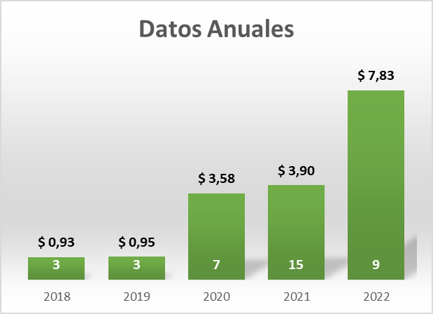
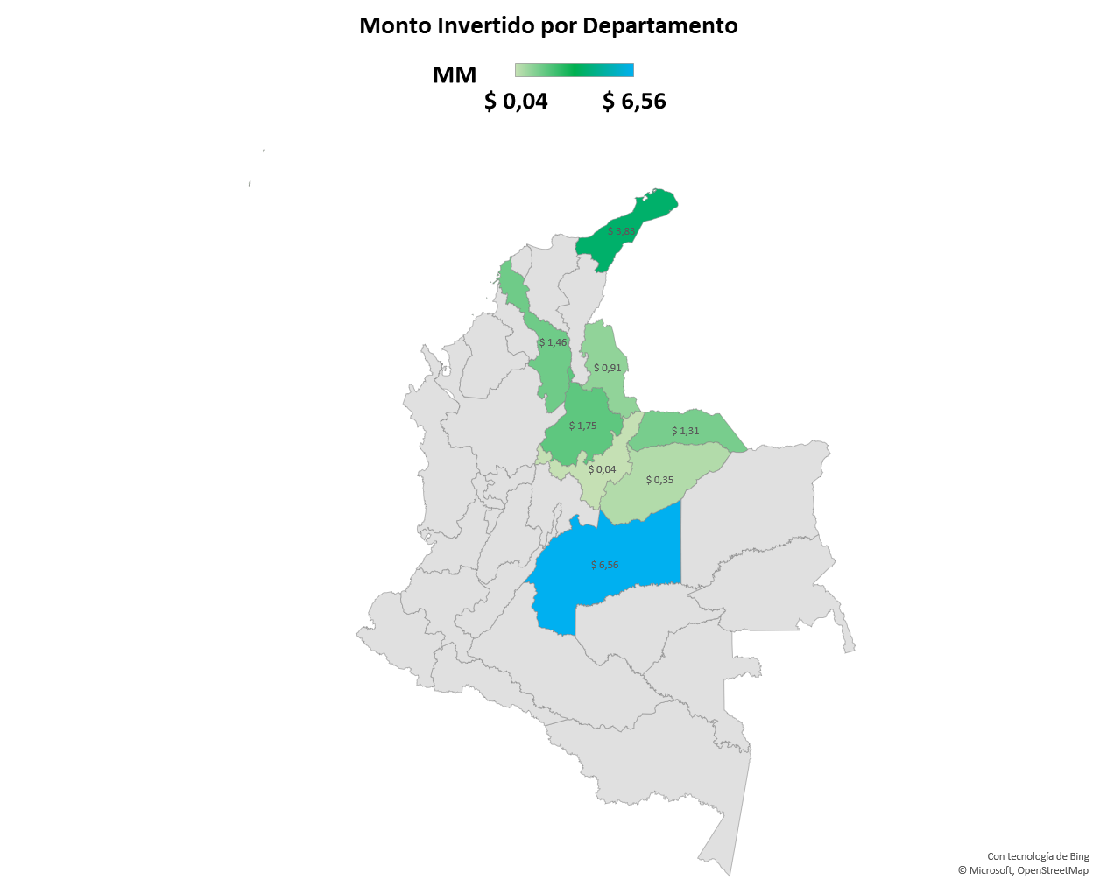
Resources - Emergency History
Carry out an exercise of historical expenditure by region, depending on risk and prevalence of emergencies.
Identification of available contract by regions Structuring contracts for emergency response in the missing regions
Investment by department 2018-2022
Emergency response has increased from 2018 to 2022, being grouped into two large categories: support with yellow machinery in Meta and Casanare and humanitarian aid through kits and markets, with more than 130 thousand people assisted in 8 departments.
Municipios | Monto | No de Proyectos
Uribia | $ 3,8 | 4
Guamal | $ 2,5 | 5
Puerto Wilches | $ 1,8 | 1
Castilla la Nueva | $ 1,6 | 1
Cartagena de Indias | $ 1,5 | 4
Villavicencio | $ 1,2 | 7
Saravena | $ 1,1 | 2
Puerto Gaitán | $ 1,0 | 1
Toledo | $ 0,8 | 1
Yopal | $ 0,3 | 1
San Andrés | $ 0,2 | 2
Arauca | $ 0,2 | 2
Acacías | $ 0,2 | 2
Aguazul | $ 0,1 | 2
Tibú | $ 0,1 | 1
Puerto Boyacá | $ 0,0 | 1
In the period analyzed, the departments with the most attention have been Meta, La Guajira and Bolívar with a total invested of approximately $7.8 billion.

Slide 8
Resources - Emergency History
Carry out an exercise of historical expenditure by region, depending on risk and prevalence of emergencies.
Identification of available contract by regions Structuring contracts for emergency response in the missing regions
Humanitarian aid
Department | Investment 2018-2022 (MM) | Average Annual Invested | Total Beneficiaries | Average Beneficiaries per project | Departmental Climate Risk
LA GUAJIRA | $ 3.833.359.565 | $ 766.671.913 | 64.200 | 32.100 | 17,23%
META | $ 2.567.951.896 | $ 513.590.379 | 10.833 | 5.417 | 16,18%
SANTANDER | $ 1.753.461.312 | $ 350.692.262 | 1.800 | 1.800 | 15,66%
BOLÍVAR | $ 1.458.765.678 | $ 291.753.136 | 30.592 | 10.197 | 18,67%
ARAUCA | $ 1.311.073.360 | $ 262.214.672 | 18.800 | 4.700 | 19,59%
Heavy machinery to assist in flood emergencies
Department | Investment 2018-2022 (MM) | Average Annual Invested | Departmental Climate Risk
META | $ 3.992.528.310 | $ 798.505.662 | 16,18%
CASANARE | $ 351.437.768 | $ 70.287.554 | 15,05%
Sources: Climate Risk (IDEAM et al., 2017. RESULTADOS - IDEAM (cambioclimatico.gov.co)

Slide 9
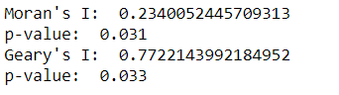
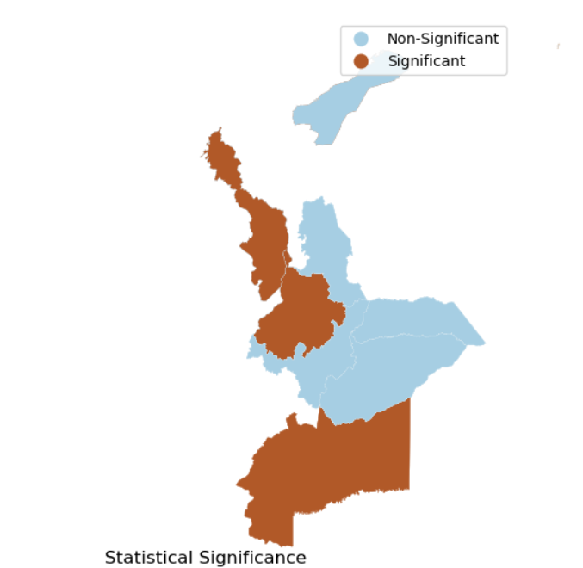
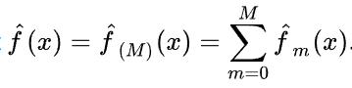
Predictive model
Transformations:
Emergency causes from 2019 to 2022 were transformed into real values with the CPI for each year based on 2018. Spatial autocorrelation was detected (Figure 1) due to similar features shared by nearby departments. Therefore, the variables Risk index, annual temperature variation and annual precipitation variation were standardized for each department with the average for each of the variables of the 3 closest departments according to the nearest k neighbors (KNN) algorithm.
Image 1. Spatial autocorrelation test:
Emergency_Resources_{it}= Risk_Index_{i} + %annual temperature rate_{it} + % annual precipitation rate_{it}
(Actual base values 2018) (Average for each apartment based on the 3 closest apartments)
i= Department; t= year
Training Set: Data from 2020 a 2022
Test set: 2018 y 2019
Image 2. Significance by department
Decision Tree with Gradient Boosting XGB Algorithm:
For the prediction, the algorithm gave greater weight to the departments with the highest spatial autocorrelation significance. At 5% confidence, the departments were Bolívar, Meta and Santander, Image 2. The estimated data on temperature and precipitation variation were taken from the IDEAM climatological bulletin for March with the predictions for the regions to September with alert for possible high magnitude of the impact of the El Niño phenomenon for next year.
The optimal parameterization to find the best prediction took into account 50 (M) decision trees estimated for the training set with the previous explanatory model, finding the best tree with the highest accuracy and lowest residuals. In each iteration, i.e. each tree, the algorithm gave lower weighting to those estimators that did not have a significant contribution to the prediction.
R² Test Set | Explanation of Variance Score
0.68 | 0.75

Slide 10
Resources - 2024 Estimate
Carry out an exercise of historical expenditure by region, depending on risk, prevalence of emergencies, etc.
Budgeting for a bag in the VDS to deal with emergencies (with this specific use)
Identification of available vehicles by regional
Structuring vehicles for emergency response in the missing regions
The estimate was based on geostatistical studies for rainfall emergencies in Nigeria (Okunlola, O.A. et al, 2021) and on the Institute of Development Studies' compilation work for the UK government on predictive models in humanitarian actions. (Hernandez, K., Roberts, T. 2020). Given the historical data of temporal and geographic emergencies, a decision tree model with spatial autocorrelation was estimated with an accuracy in the test data of 68%, see slide annex 1. It was estimated with data extracted from the IDEAM of the climate change risk index for each department, percentage variations in annual temperature and annual precipitation and own data on the investment in emergencies for each department from 2018 to 2022. It was estimated under 3 scenarios, the medium scenario corresponds to the prediction of the model for the departments with Ecopetrol presence that were part of the historical in the last 5 years (Arauca, Bolívar, Casanare, Meta, La Guajira, Norte de Santander, Santander). The high scenario corresponds to the sum of the medium scenario plus the average of the estimate of the 5 departments with the highest risk of climate change according to the IDEAM index. The low scenario is the average of the actual causation, based on 2018, of the last 3 years.
Emergency_Resources_{it}= Risk_Index_{i} + %annual temperature rate_{it} + % annual precipitation rate_{it}
(Actual base values 2018) (Average for each apartment based on the 3 closest apartments)
i= Department; t= year
Low scenary | Medium scenary | High scenary
$ 5,9 mM | $ 7.4 mM | $ 8.8 mM

Slide 11
Referencias
Hernandez, K. and Roberts, T. (2020). Predictive Analytics in Humanitarian Action: a preliminary mapping and analysis. K4D Emerging Issues Report 33. Brighton, UK: Institute of Development Studies. Predictive analytics in humanitarian action: a preliminary mapping and analysis - Institute of Development Studies (ids.ac.uk).
IDEAM, PNUD (2017). 3ra Comunicación Nacional de Cambio Climático. Convención Marco de las Naciones Unidas sobre Cambio Climático. http://www.cambioclimatico.gov.co/3ra-comunicacion-cambio-climatico
Okunlola O. A., Olubusoye O. E., Ayinde K., Lukman A. F., Szcs I. (2021). Spatial regression and geostatistics discourse with empirical application to precipitation data in nigeria. Sci. Rep. 11, 16848. 10.1038/s41598-021-96124-x - DOI - PMC – PubMed. Spatial regression and geostatistics discourse with empirical application to precipitation data in Nigeria - PubMed (nih.gov)
Unidad Nacional para la Gestión de Riesgos de Desastres, 2022) . Informe Plan Nacional de respuesta, segunda temporada de lluvias.

Slide 12


